Slide 1

Smart Blind Stick
Mubeena Nazar
S4 MCA
Roll No : 41

Slide 2
Agenda
Literature Review
Proposed System
IoT Equipment
Timeline
Next Step

Slide 3

Existing System
Multi-Functional
Blind Stick for Visually
Impaired People
Smart Stick for Blind People
Uses IoT
Detect obstacles
Range in 4m
Buzzer to find stick
Uses IoT
Detect obstacles
Detect staircase
Sending message
Adding or removing phone numbers

Slide 4

Existing System
Low Cost
Smart Navigation System for the Blind
Visually Impaired Smart Assistance
Uses IoT
Detect Obstacles
Voice assistance
Staircase prediction
Uses IoT
Detect Obstacles
Smart Phone application

Slide 5

Proposed System
Detect obstacles
Detect Water
Detect Fire
Identify potholes
Predict staircase
Provide buzzer
Vibrator
Senses the light Intensity
Location tracker
Emergency button

Slide 6
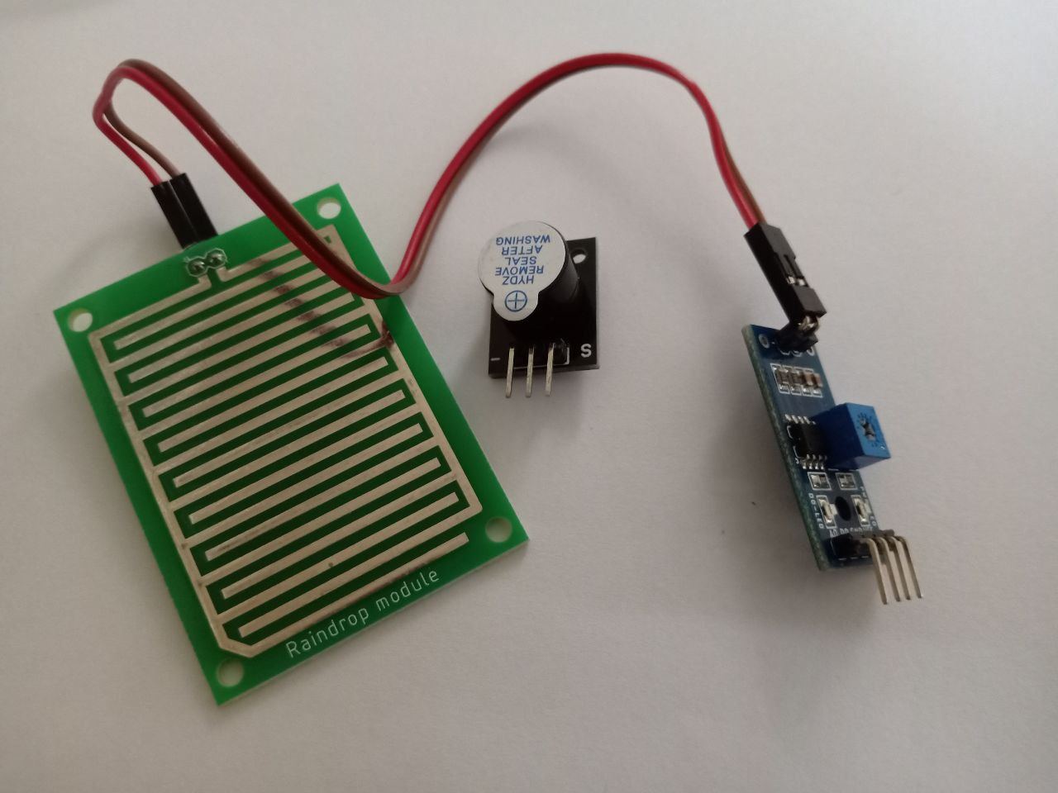
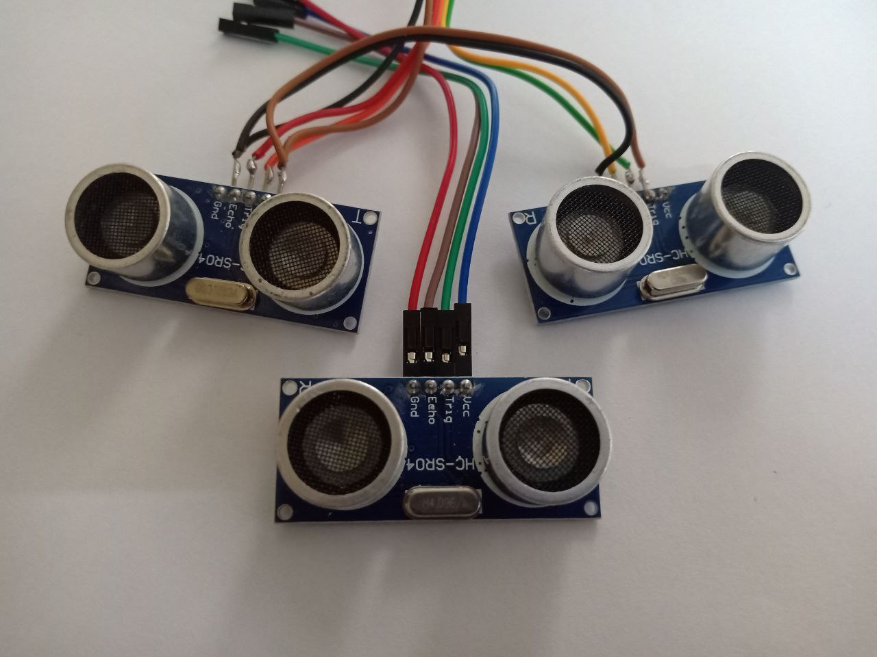
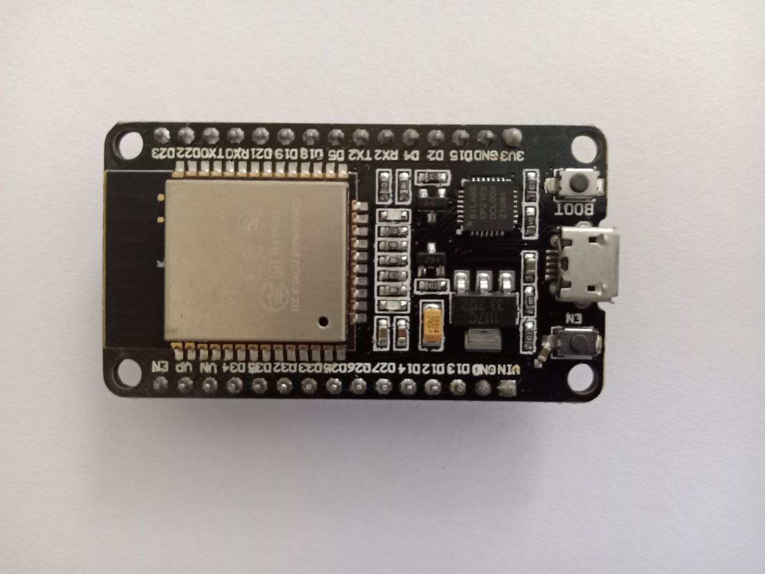
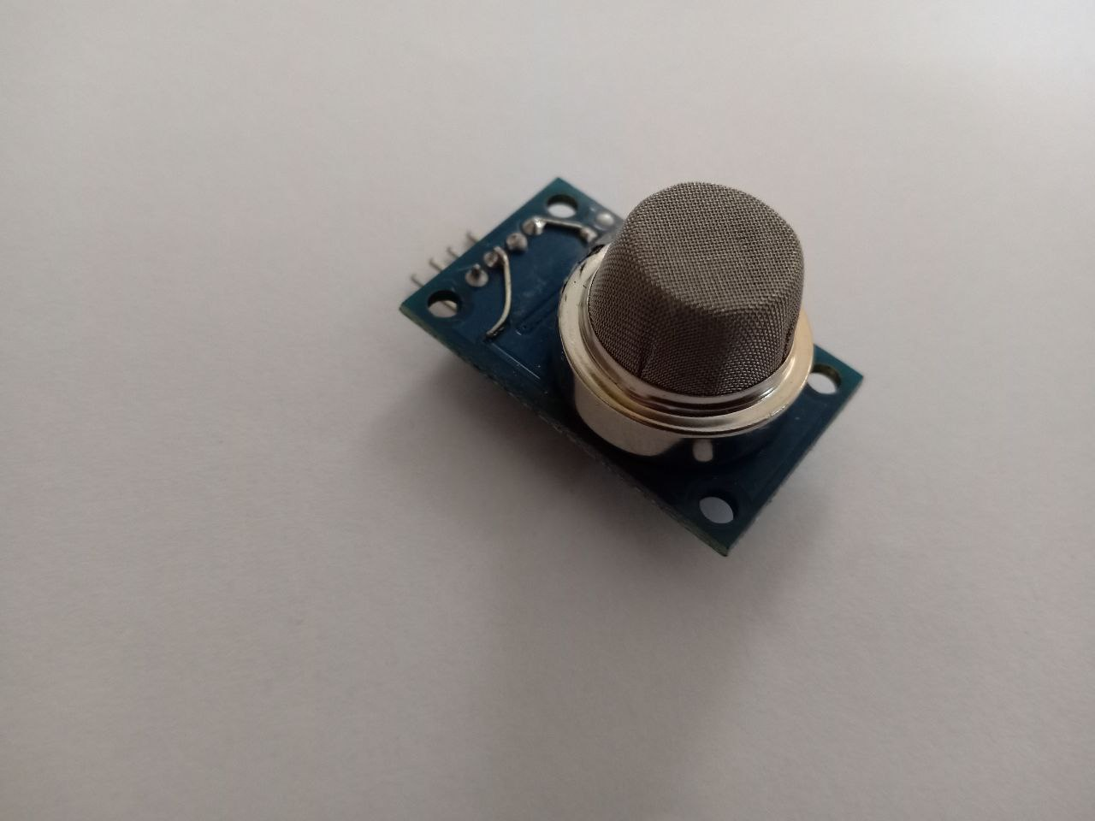
Equipment

Slide 7

DIAGRAM
Detection of Water
Detection of
Heat
User
Detection of
pothole
Detection of obstacle
Detection of staircase

Slide 8
TIME LINE
Topic Finalized
23-4-22
Abstract
25-04-22
Approval meeting
Literature Survey
Scrum meeting 1
28-04-22
30-04-22
15-05-22
Preparing with base papers
Ordered Equipment
10-05-22
19-05-22
Scrum meeting 2
21-05-22

Slide 9
NEXT STEP
Connections of devices with ESP32
Preparing Programme for
Obstacle detection
Staircase detection
Water detection
Developing new ideas for more integration of internet with the stick in cost effective manner.

Slide 10

Thank You

